Slide 1

The Franchise

Slide 2


An Overview
Established for 12 years.
Delivering professional part time stage schools in centres across Great Manchester and the North
An excellent reputation with schools in the area.
Salford Business Awards Entrepreneur of the Year 2016 and Community Award Winner 2016
Delivering high quality educational packages to the community.
Producer of professional theatre performances on issue based topics

Slide 3
Footlights Theatre Schools
Footlights’ Head office currently operates seven theatre schools, in Cheadle, MediaCityUK, Prestwich, Urmston and Wigan
In addition, there are 12 Footlights’ franchises, in Ashton under Lyne, Bolton, Burnage, Eccles, Failsworth, Grimsby, North Manchester, Old Trafford, Rochdale and Salford.
Each franchise operates independently; the Director is responsible for hiring premises and teaching staff, recruiting new members, and running the school in an efficient way.
From the beginning, each franchisee receives two full weeks’ training, a complete A- Z of running your franchise in the Manual and ongoing support.
At the core of all the activity is the Footlights’ brand and reputation – your success is our success.

Slide 4
Footlights Wigan -
An example of possible revenue v profit 2017
Tinys are 4 - 6 years
Main School are 7 - 18 years
So…
If you had 35 Main School and 9 Tinys, your Gross Profit would be £4,947.50 per term, £14,834.25 pa for just one morning per week.

Slide 5
The Training
Induction – a comprehensive introduction to Footlights and running a Footlights Satellite School
Processes – in-depth training in efficient processes to enable franchisees to manage and develop their Satellite School
Networking – the opportunity to share ideas and experience with other Footlights’ franchisees
Support – ongoing advice and guidance throughout
Successful Franchising
Induction
Processes
Networking
Support

Slide 6
Costs – What do you get for your money?
Initial Outlay
Ongoing Costs
A turn key business currently operating at a profit.
A complete business model, tried and tested.
Part of a network of schools with full support.
An income of approximately £1,000 per month without any marketing.
A fully staffed stage school with existing clients.
10% Management Fee of Gross Turnover.
Hiring of premises and staff – costs that are currently covered by income.

Slide 7
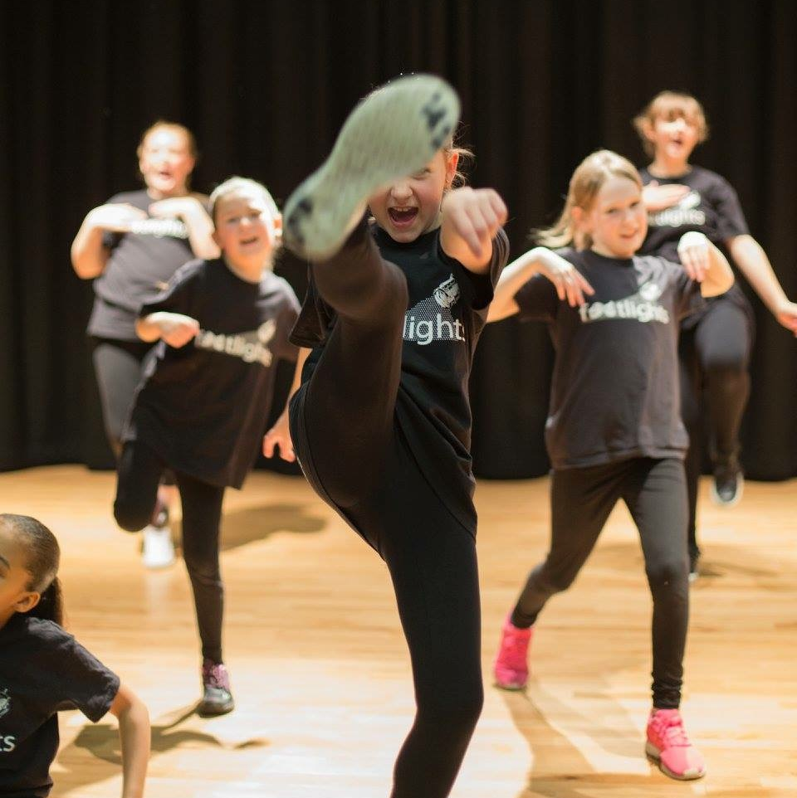
Footlights Wigan
Could you take it to the next stage?
Act Now! You could be running your own business in 2017

